Slide 1


HUM 102 Report Writing Skills
Lecture 17

Slide 2

Previous Lecture
Format of Memo
Structure of Memo

Slide 3
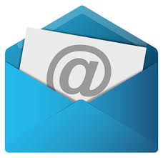


Email Writing
Electronic Correspondence
Correspondence through “Internet”
The information superhighway
Global information system
A system of sending messages from one individual to another person/group via telecom links between computers using dedicated software (Dictionary.com).

Slide 4
Email Writing
About Email
electronic + mail = Email
Electronic version of letter
Most used and popular services on Internet
Enables messages to be transferred from an individual (sender) to another individual (receiver) or from an individual to a group of people (receiver)
Documents (audio, video, pictures, etc.) can also be attached

Slide 5

Email Writing
Categories: Objective-wise
Self-Fulfilling Email: Information/Compliment, no reply is necessary
Inquiries: Advice or Answer required from the audience. Reply is the desired outcome
Open-Ended Dialogue: Keeping communication lines open for improved future results
Action Email: Action on the part of receiver is required

Slide 6


Email Writing
Advantages
Can be sent to anyone anywhere
Cost-effective and quick
Convenient

Slide 7

Email Writing
Important Assumptions – Our goal is to construct email that:
will actually be read
will actually be understood
will not annoy the receiver
does not take up too much time on the receiver’s end

Slide 8
Email Writing
Understanding a Receiver
May/may not be getting a lot of emails
May/may not be receiving a regular set of standard questions
May/may not have free time
Does/does not mind helping others

Slide 9

Email Writing
Steps of Effective Email Writing [1/3]
Determine your desired outcome
Jumping to the point
Use as few words as possible, introduce who you are, context if necessary, and why you are emailing, etc.
State the incentives and benefits of receivers rather than the sender
Keep it simple
Stick to the facts

Slide 10
Email Writing
Steps of Effective Email Writing [2/3]
Pretend first face to face introduction
Pretend you are using a mobile device or tab for communication
Add friendly comment (e.g., enjoying weekend)
Be authentic and realistic with conversational English
Font size and style makes a difference

Slide 11
Email Writing
Steps of Effective Email Writing [3/3]
Format matters (bullets, list, short paragraphs, bold, italics)
Minimize questions (not more than 1 or 2)
If needed, ask specific (close ended questions) rather than confusing questions
Rephrase: Trim sentences to avoid unnecessary details

Slide 12



Email Writing
What do I need to send and receive email?
Computer, laptop, tablet, smart phone, etc.
Stable internet connection
Email address managed by respective organization/systems

Slide 13




Email Writing
Popular Email Service Providers
Gmail
Hotmail
Yahoo
Juno
Excite

Slide 14
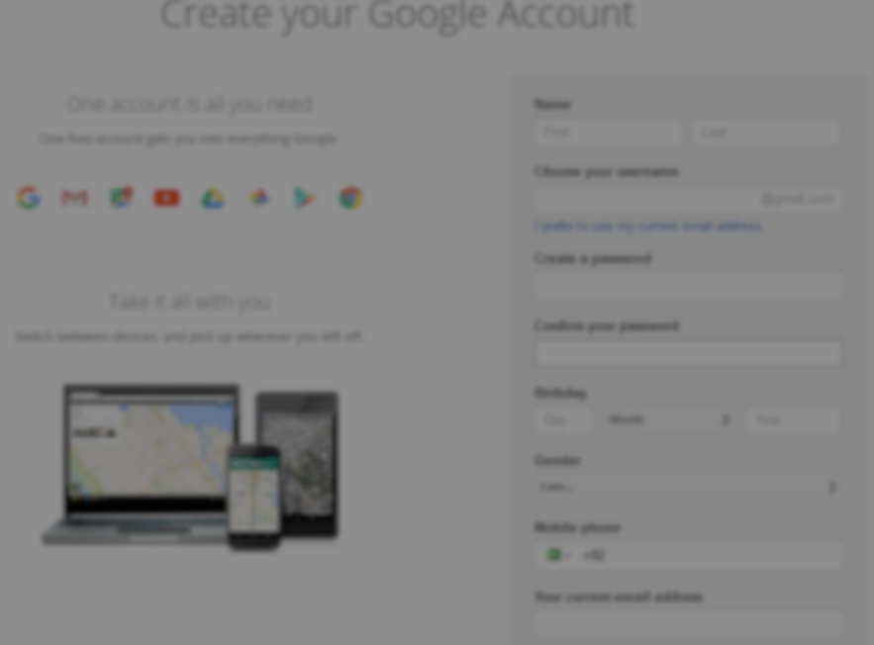
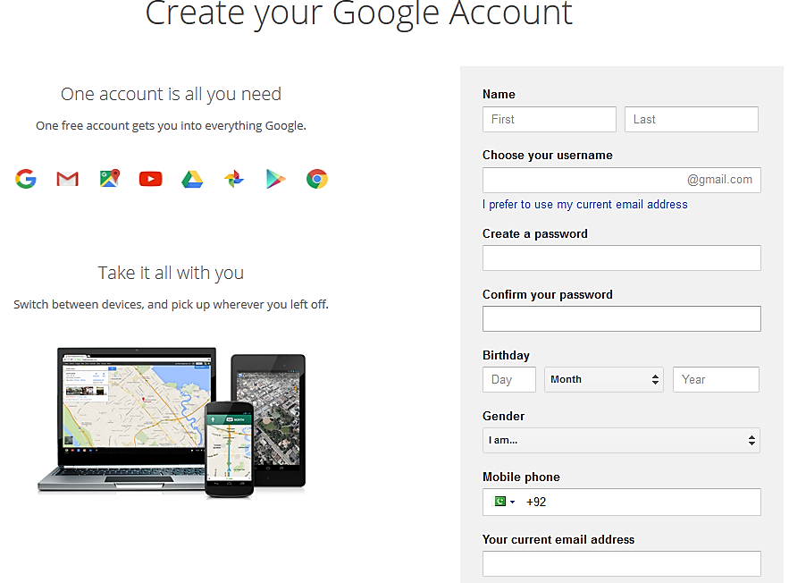
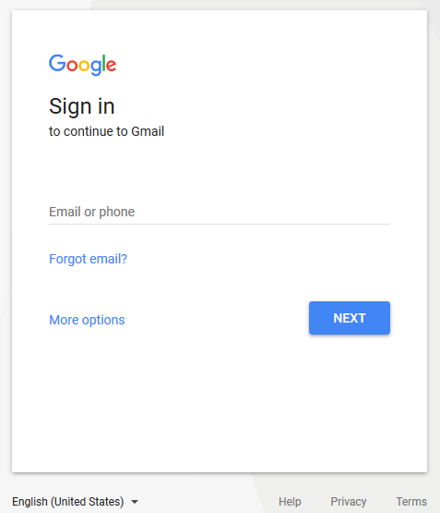

Slide 15

Email Writing
How to make an effective email address?
Signing Up
Adding personal information, number, address for verification
Selecting a Username and Password
Username has to be professional, e.g.,
wajid.malik@gmail.com
tayyaba_asghar@yahoo.com
The following are not recommended
handsome89@gmail.com
pakistani312@hotmail.com

Slide 16
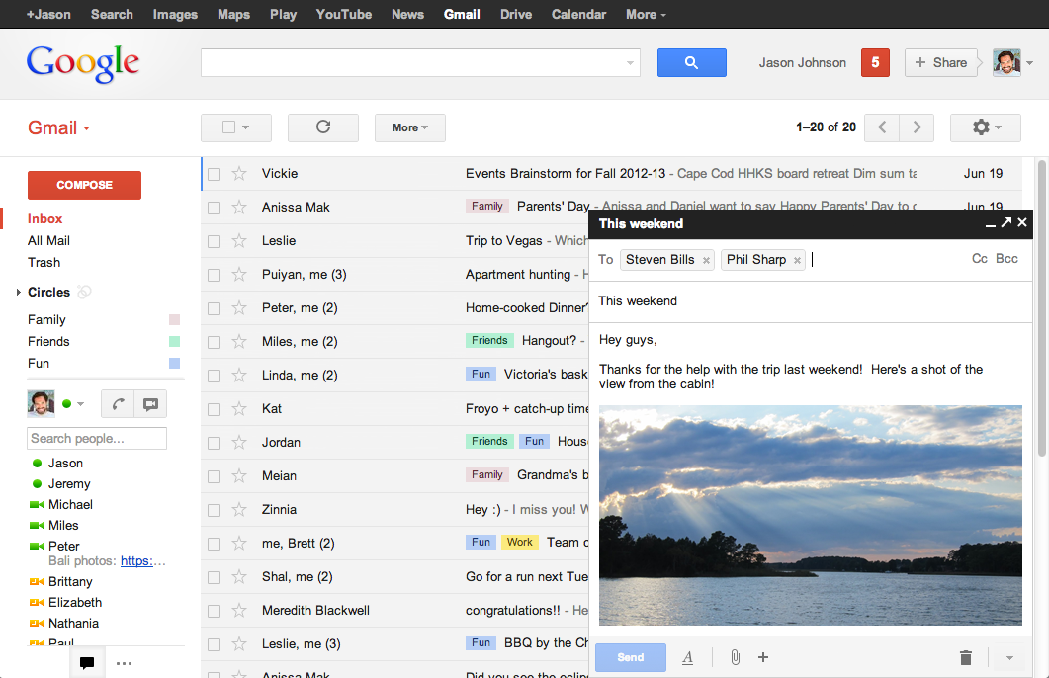
An Email Sample

Slide 17
Audience
Email Writing
Email | Generally multiple readers with various levels of knowledge Could include instructors Company supervisors Subordinates as well as family and friends
Topic
Email | A wide range of diverse topics determined by audience

Slide 18
Email Writing
General Format and Tone
An email in general has two parts: Head + Body
Typically one viewable screen with 60-70 characters per line
Beyond these parameters, a reader must scroll
12-14 lines per screen
Usually informal
Due to the “conversational” nature of electronic communication

Slide 19
Email Writing
Email Structure
Head
Email Text
Closing
Greeting

Slide 20
Email Writing
Email Structure: Head [1/2]
Identification lines include:
To (reader's name and email address)
Cc (Carbon Copy)
Bcc (Blind Carbon Copy)
Subject

Slide 21
Email Writing
Email Structure: Head [2/2]
The header always contains a clear subject line.
This is a very important part of the message and you should always include a subject line.
Some folks sort their messages by subject, so it is rude to not include a subject!
The subject line indicates the purpose or content of the message.

Slide 22
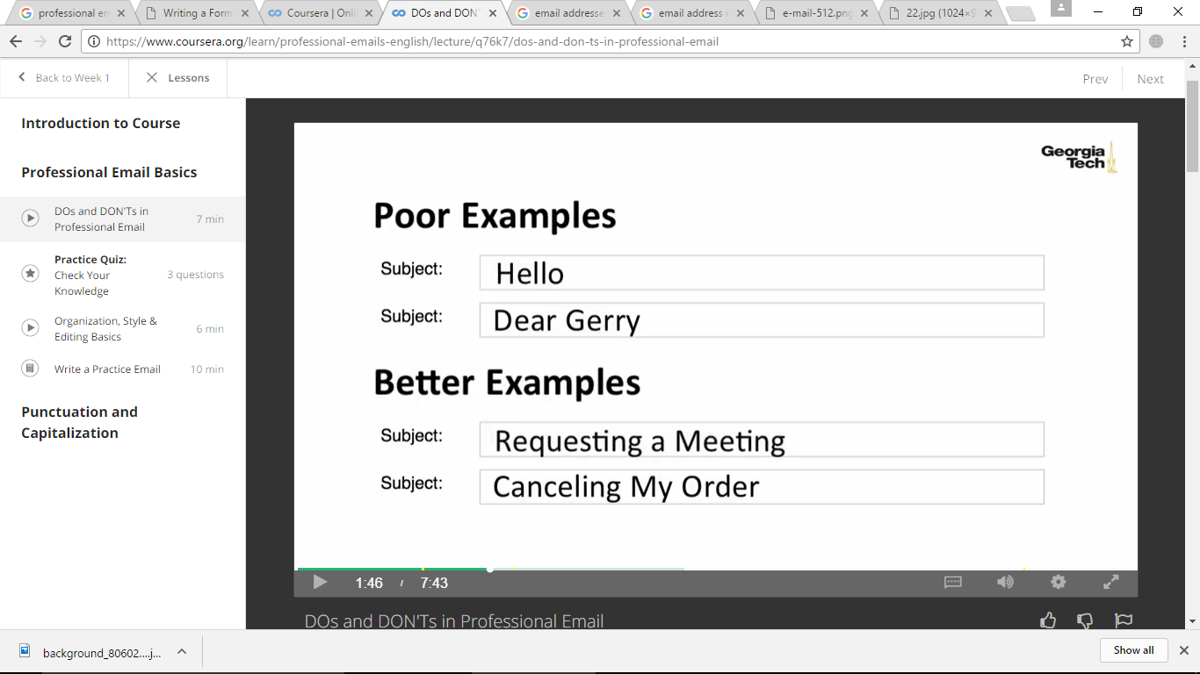
Email Writing
Email Structure: Subject Line as Head Line [1/4]
Never leave the subject line empty
It should briefly introduce the topic of the email

Slide 23
Email Writing
Email Structure: Subject Line as Head Line [2/4]
Grabbing the Attention
Getting to the Point
Bad Example*
Subject: Meeting
Good Example*
Subject: Reminder of 10am Meeting Sched. 10/05 on PASS Process
*Source: http://www.mindtools.com/CommSkll/EmailCommunication.htm

Slide 24
Email Writing
Email Structure: Subject Line as Head Line [3/4]
Focused, Clear and Informative
Correct Subjects
Invitation to the ABC Conference, Nov 2009
Application for Account Manager Position #413 – Jane Smith CV
Agenda for the meeting on Monday, 10am
Party Invitation for John, Sally and Martin
Updates on the building plans
Meeting scheduled for Oct 15, Thursday @ 10am
Great craft ideas using recyclable materials
*Source: http://www.qgroupplc.com/?catid={C07567E5-9742-4A9F-8940-261D1E629EC5}#{4FB078D9-DD5A-4058-9FB1-B635C84261FB

Slide 25
Email Writing
Email Structure: Subject Line as Head Line [4/4]
Weak Subjects
[blank]
Hi, Hello, How are you?
First line of the email message
Whole Email in Subject Line (Most Common Error)
Words to avoid: Help, Percent Off, Reminder, Free
*Source: http://www.qgroupplc.com/?catid={C07567E5-9742-4A9F-8940-261D1E629EC5}#{4FB078D9-DD5A-4058-9FB1-B635C84261FB

Slide 26
Email Writing
Email Structure: Greetings [1/3]
If you are unsure about the addressee’s gender or name, use their designation for addressing the greeting.
For Example:
Dear Professor Madani
Dear CEO Telenor Pvt. Ltd
Dear Director CIIT

Slide 27
Email Writing
Email Structure: Greetings [2/3]
If you are ONLY sure about the addressee’s gender and NOT their designation, then use that information.
For Example:
Dear Sir
Dear Madam

Slide 28
Email Writing
Email Structure: Greetings [3/3]
Examples*
Dear [name],
Hi [name],
Hi,
Hello [name],
Hello,
To whom it may concern,
*Source: http://www.qgroupplc.com/?catid={C07567E5-9742-4A9F-8940-261D1E629EC5}#{4FB078D9-DD5A-4058-9FB1-B635C84261FB

Slide 29
Conclusions
Basics of Email
Steps of Effective Email Writing
Email Structure (to be continued…)

